Slide 1





IPTIF
AGNI UG Fellowship
Empowering Indian Safety:
Surveillance Spider Bot
(Focus Area under the call of Safety & Defence)
Sharon Mathew( URK21RA1008 )
(Karunya Institute of Technology & Sciences)
Dr. P. Kingston Stanley,
(Karunya Institute of Technology & Sciences)

Slide 2
Work done till now...
Plan of activity for 3-6 months
Description | 1ˢᵗ Month | 2ⁿᵈ Month | 3ʳᵈ Month | 4ᵗʰ Month | 5ᵗʰ Month | 6ᵗʰ Month
making a simple prototype of SpiderBot
Design of Actual SpiderBot Prototype
Programming and System Calibration
Final prototype and testing
Publication

Slide 3
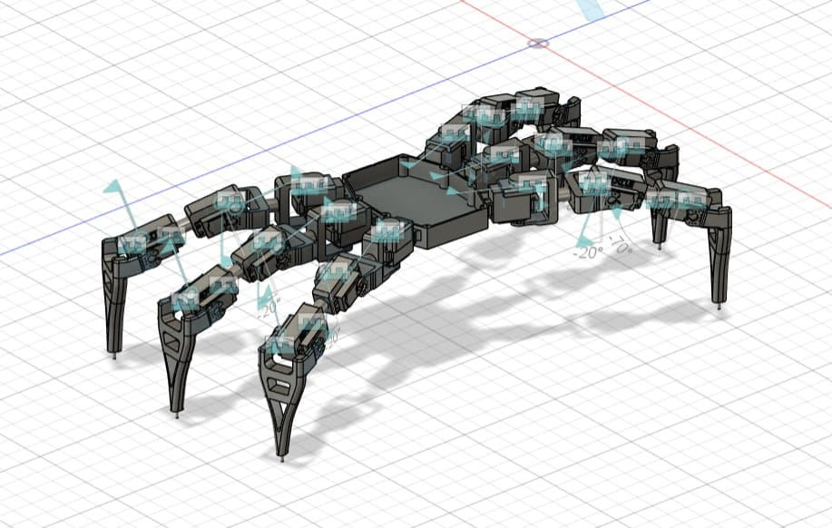
Making a Simple Prototype of SpiderBot
This is one of the 3D prototype model that
l have created using Fusion360 software in a very simple manner to know the movements of each joints and angles of the 18 DOF SpiderBot.

Slide 4
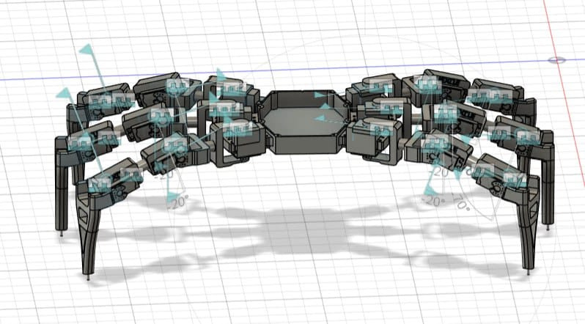
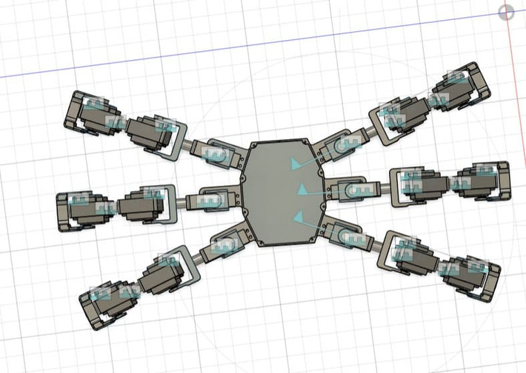
Making a Simple Prototype of spiderBot
Views
from different angles
Side View
2. Front View
3. Top View

Slide 5
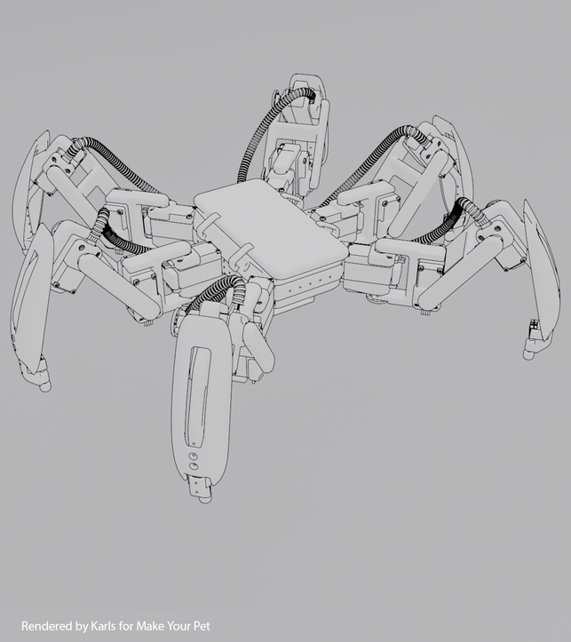
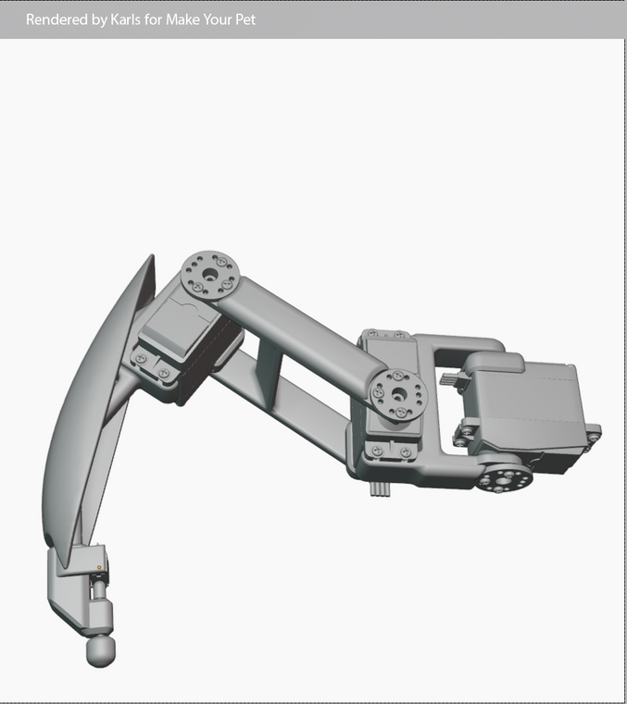
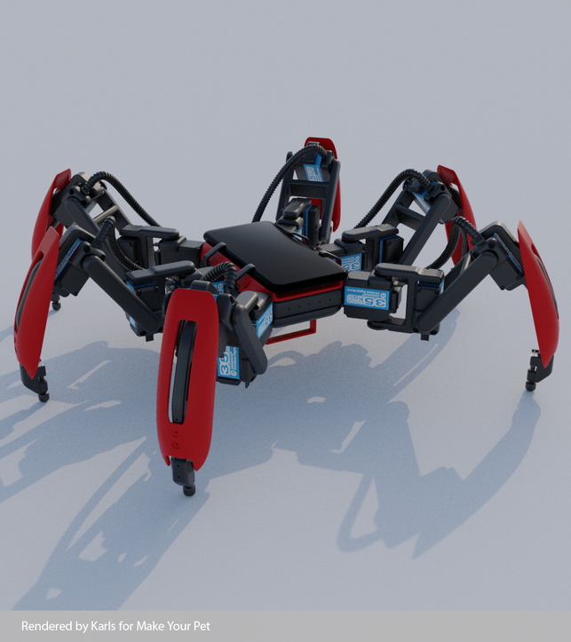
Sample designs from internet for design ideas
I have also taken some sample prototype designs from the internet to help me get some idea in designing a 3D model of the Spiderbot .
These designs are more reliable, compact and less complex
than the designs I made.

Slide 6
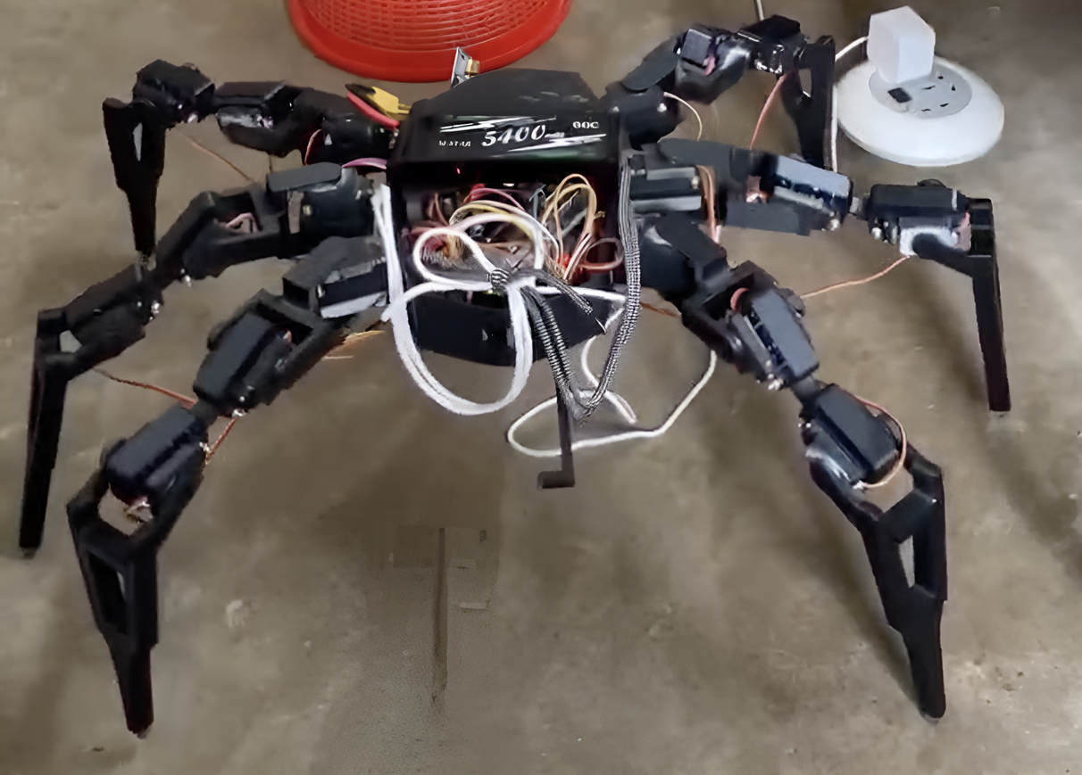
Printed Spider Bot model
The 3D designed model of the Spider Bot from the sample prototype is printed and assembled with the components

Slide 7
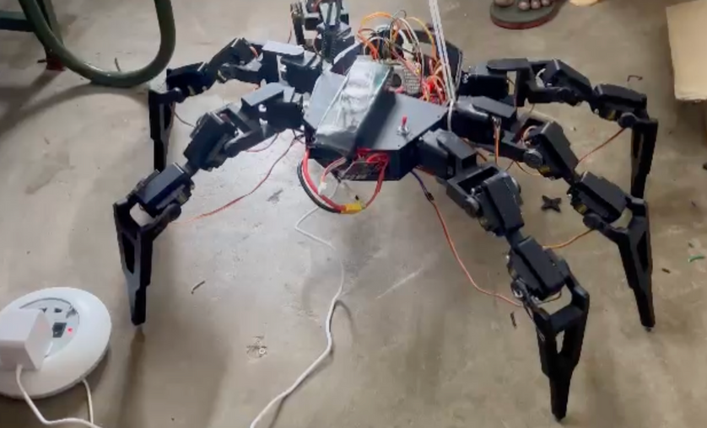
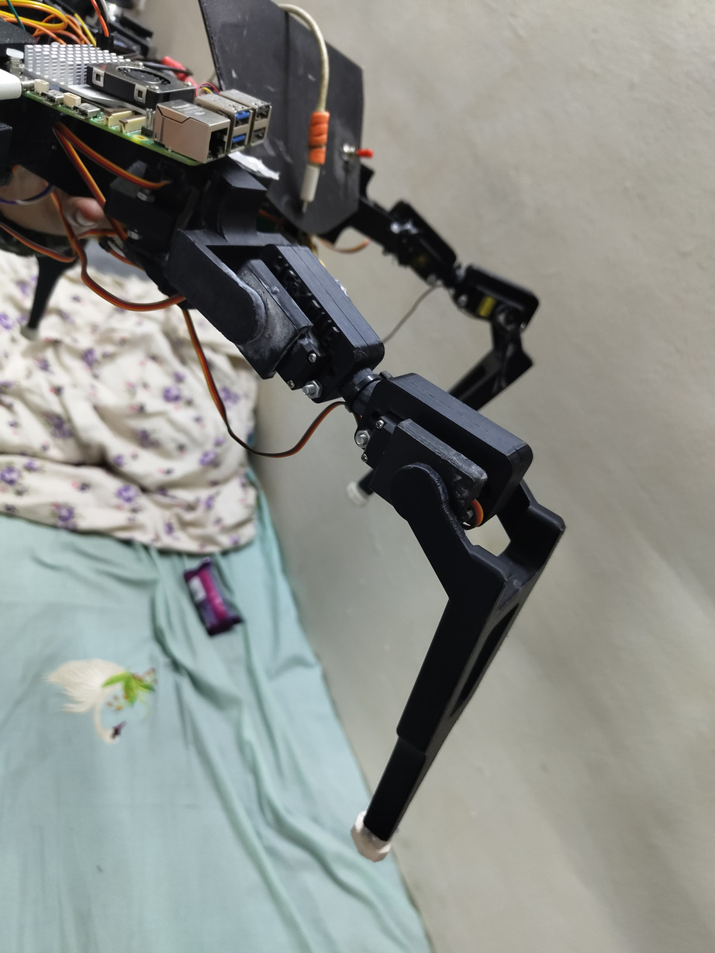
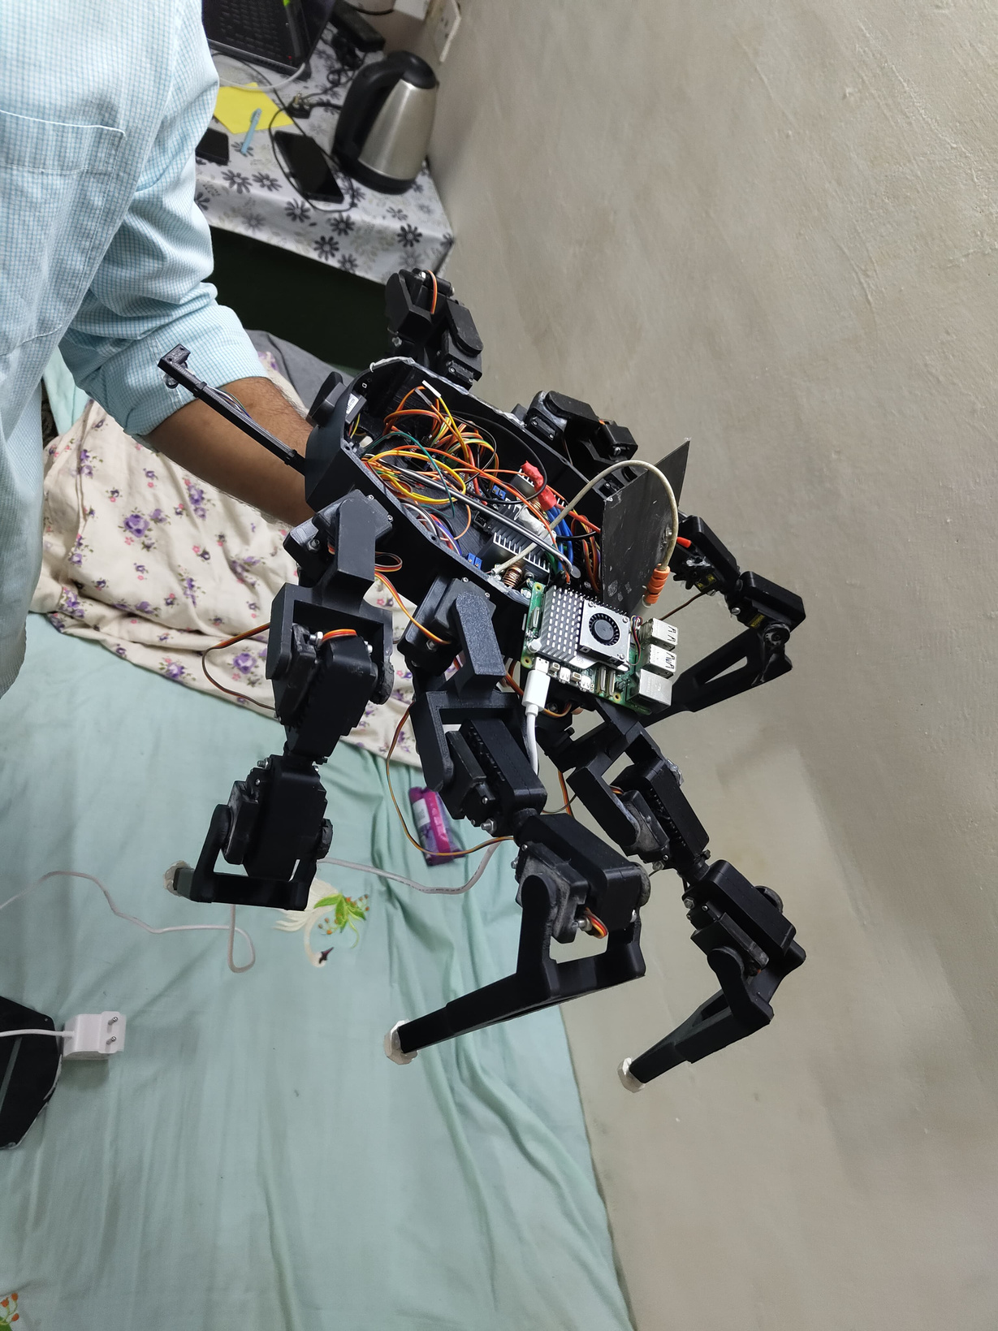
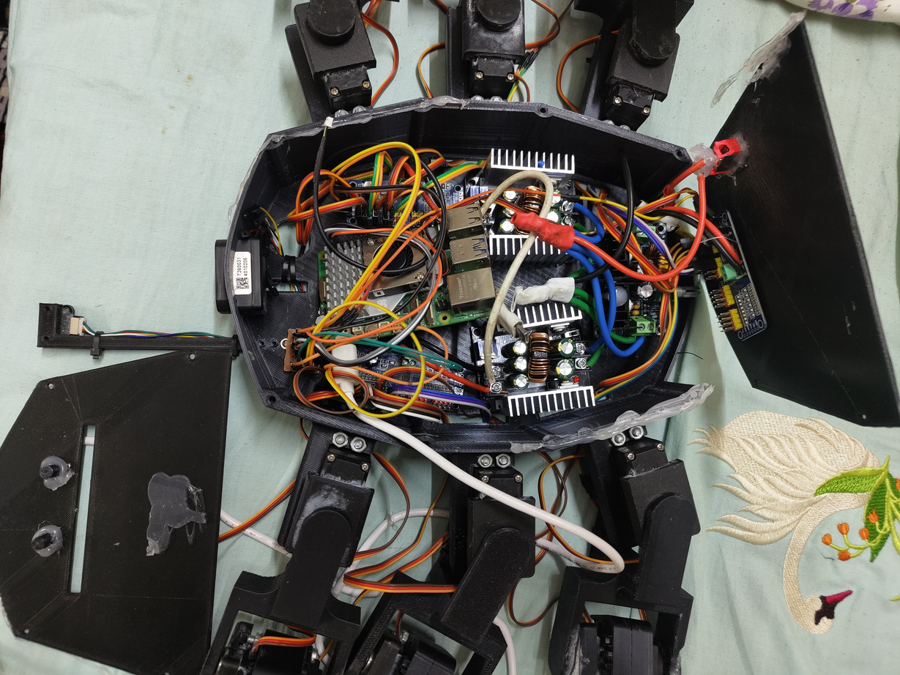
Printed Spider Bot model

Slide 8
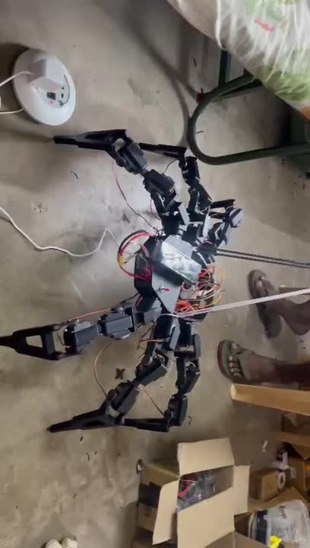
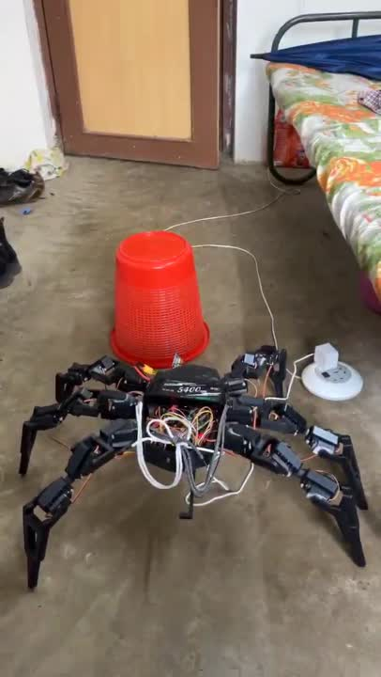
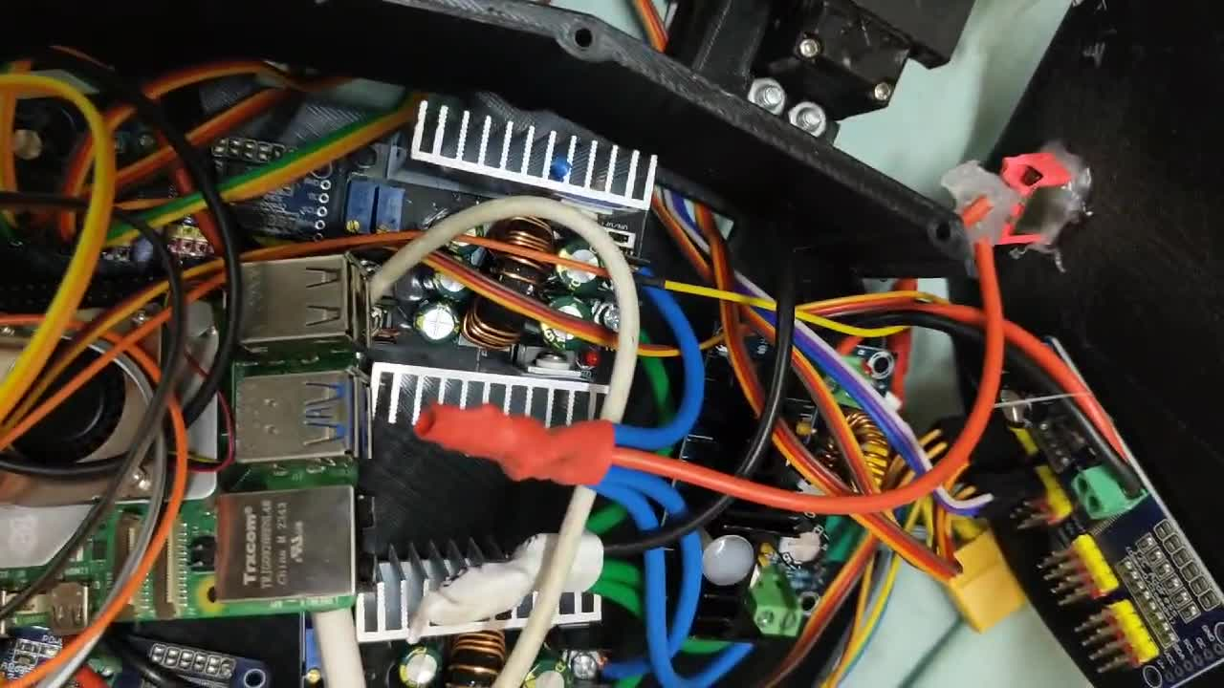
Videos of Spider Bot Movement
* videos wont play as it is in ppt format
Testing the movement of the SpiderBot
Internal
assembly
of the components

Slide 9
Components Bought and used:
Raspberry Pi 5 Model 8GB
PCA9685 16 Channel Servo Motor Driver x3
MG995R Metal Gear Servo Motors x18
XH-M401 DC-DC Step down Buck converter x3
TOF1020 Laser Range Sensor
Waveshare IMX219-83 Stereo Camera
5400mAh Li-Po Battery
Husky lens - AI Camera

Slide 10
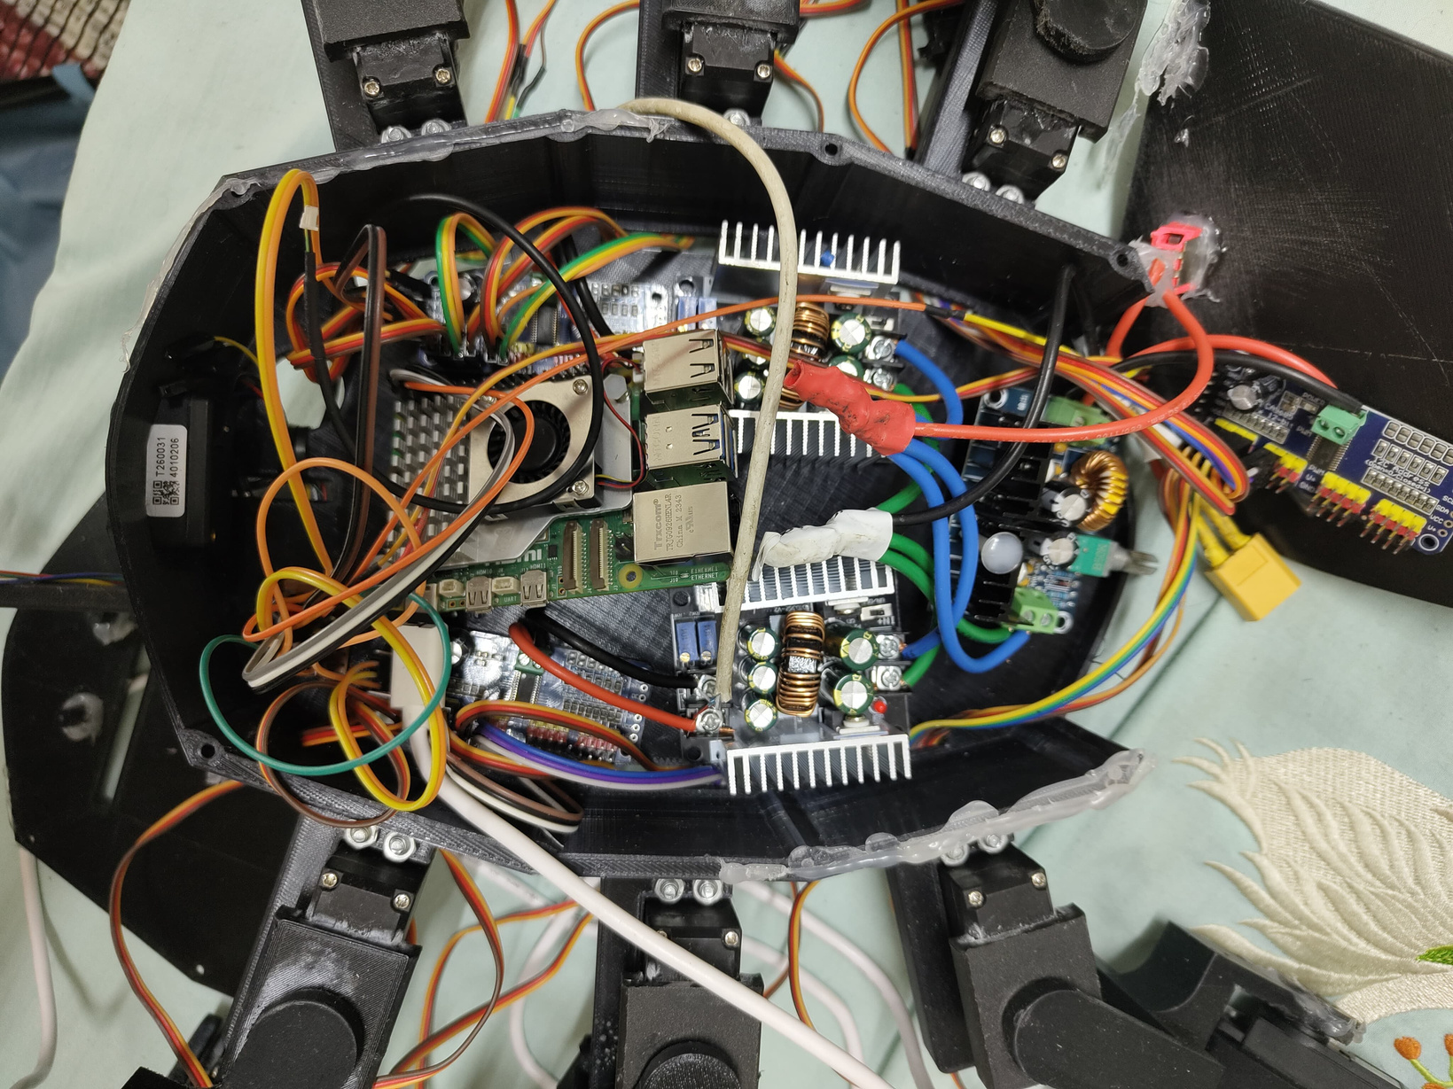

Components used inside the Spider Bot
XH-M401 DC-DC Step down Buck converter
Raspberry Pi 5 Model 8GB
PCA9685 16 Channel Servo Motor Driver
TOF1020 Laser Range Sensor
XH-M401 DC-DC Step down Buck converter x2
PCA9685 16 Channel Servo Motor Driver

Slide 11
Work done till now:
The 3D designing and printing of the Spider Bot is finished.
The components are bought and assembled.
The programming and system calibration part is going on as of now.
The movement of the robot legs with balance was successful.

Slide 12
Problems faced:
There are some challenges in the coding area, which I am currently working on to resolve. These challenges include finding the kinematics of the robot legs, stability while movement, etc.
Weight of the Spider Bot needs to be decreased.
Power supply regulation, due to which one of the legs got damaged.
Quick draining of Battery pack- company manufacturer problem.
Sensor calibration and testing is remaining big challenge.

Slide 13
Future Developments:
Sometimes the design may be changed to decrease the size of the Spider Bot.
Alternate methods of sensing- using Husky lens.
Developing proper code after checking the kinematics of the leg movements.
Optimising the model by testing the Spider Bot in various conditions in real time.

Slide 14
Thank You

